Slide 1
University of Veterinary and Animal Sciences, Lahore
17th Meeting of QECs Heads
Dr. Dawar Hameed Mughal
Director QEC

Slide 2
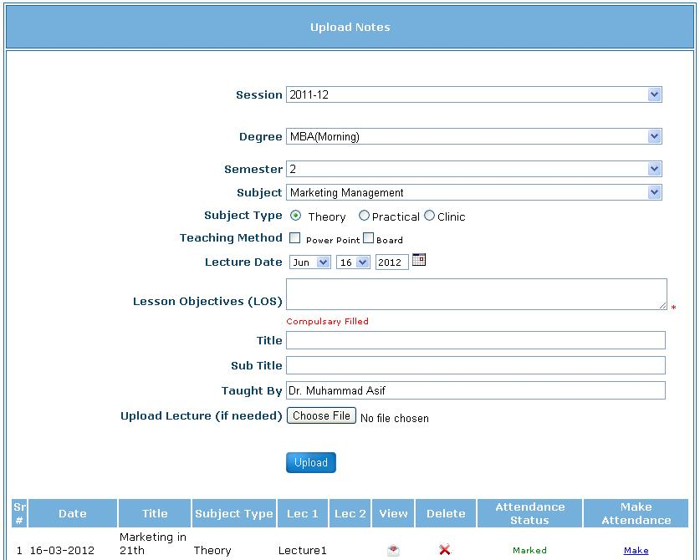
Course Teaching System

Slide 3
Teaching Evaluation Forms:
Theory
Practical
Clinics

Slide 4
Course Evaluation
Online Course Evaluation

Slide 5
Faculty Course Review Form (Comments of Feed back)
Students (Course evaluation questionnaires)
Curriculum (HEC approved/revised National Curriculum Guidelines)
Assessment ( Continuing effectiveness of the method(s) of assessment in relation to course objectives)
Enhancement: (Implementation of changes in early course review report)
Outline changes in future delivery of structure of the course

Slide 6
Problems Encountered
Students like to finish evaluation forms at once
Evaluating statement(s) may be overlooked
Faculty reservations over Faculty Course Review Form
Repetition of information
Standard/level of Question Paper
Time availability

Slide 7
Follow up Actions
Feed back is sent to concerned teachers and Chairman of the Department
Departmental meetings arranged to discuss identified issues
Action plan preparation by the Department
Implementation of action plan
Follow up the action taken by the Department

Slide 8
Impact/Outcome of Evaluation
Teachers remain alert in classes
Improvement in teaching and its methodology
Identification of weaknesses and strengths of a teacher
Sharing of course contents delivery at departmental level increased
Structure and objectivity of the course improved
Outcome based course teaching increased
Competency of the teachers enhanced

Slide 9
THANK YOU

